Slide 1
CHAPTER 2 Methods of Enquiry in Psychology

Slide 2
Goals of Psychological Enquiry
Description
Prediction
Explanation
Control
Application

Slide 3
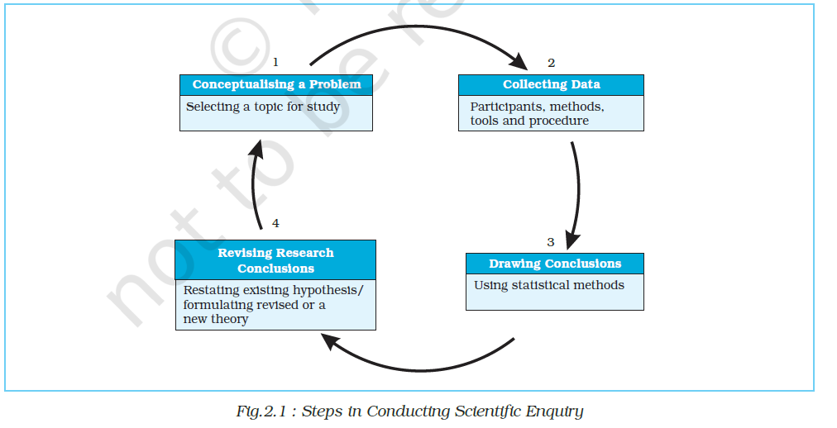
Steps of conducting Scientific Research

Slide 4
Steps of conducting Scientific Research
The scientific method attempts to study a particular event or phenomenon in an objective, systematic, and testable manner.
Objectivity
Systematic
Conceptualizing a problem
Collecting Data
Drawing Conclusions
Revising research Conclusions.
Testable

Slide 5
Steps of conducting Scientific Research
Systematic
Conceptualizing a problem
Diverse range of problems
Understanding our own behaviour
Understanding other individuals behaviour
Group influences on individual behaviour
Group behaviour
Organisational level
Hypothesis
Collecting Data
Drawing Conclusions
Revising research Conclusions.

Slide 6
Steps of conducting Scientific Research
Systematic
Collecting Data
First decision
Participants in the study
Methods of data collection
Tools to be used in research
Procedure for data collection
Second decision
Methods of data collection
Observation method
Experimental method
Correlational method
Case study.
Third decision
Tools of research
Interview schedule
Observation schedule
Questionnaire
Fourth decision
How the tools need to be administered to collect data
Individual
Group

Slide 7
Steps of conducting Scientific Research
Systematic
Drawing Conclusions
Analyse data by statistical procedures
Graphical representations
Use of statistical methods
Revising research Conclusions.

