Slide 1
Term 2
Learn Psychology with Vishal Pandey
Chapter 6 Learning

Slide 2
Learning
Nature of Learning
Features of Learning
Learning always involves some kinds of experience
Behavioural changes that occur due to learning are relatively permanent.
Learning is an inferred process & is different from performance.
Paradigms of Learning
Classical Conditioning
Operant Conditioning
Observational learning
Cognitive Learning
Verbal Learning
Concept learning
Skill learning

Slide 3
Learning
Classical Conditioning – Ivan P. Pavlov
Unconditioned Stimulus (US)
Unconditioned Response (UR)
Conditioned Stimulus (CS)
Conditioned Response (CR)

Slide 4
Learning
Determinants of Classical Conditioning
1. Time Relations between Stimuli
Simultaneous Conditioning (CS = US)
Delayed Conditioning (CS_US)
Trace Conditioning (CS_| US)
Backward Conditioning (US_CS)
2. Type of Unconditioned Stimuli
Appetitive – Pyaar se automatically
Aversive - Jabardasti
3. Intensity of Conditioned Stimuli
Ex:- Pitai

Slide 5
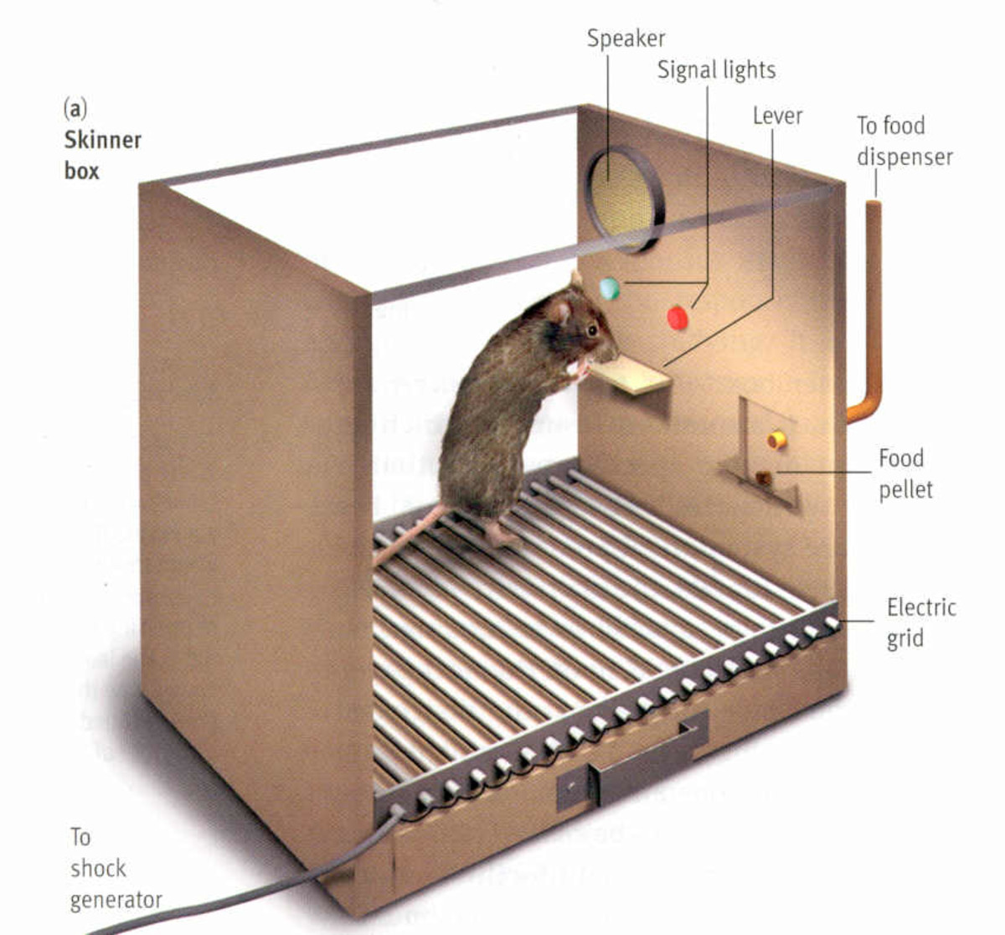
Learning
Operant Conditioning – B.F.Skinner
Determinants of Operant Conditioning
Operant or Instrument conditioning is a form of learning in which behaviour is learned, maintained or changed through its consequences. Such consequences are called reinforcers.
A reinforcer is defined as any stimulus or event, which increases the probability of the occurrence of a (desired) response.
Reinforcer features:
Types (Positive or Negative)
Number or frequency
Quality (Superior or Inferior)
Schedule (Continuous or intermittent)
Nature of the response or behaviour
Interval between response & reinforcement

Slide 6
Learning
Key Learning Processes
Reinforcement
Reinforcers are stimuli that increase the rate or probability of the responses that precede.
A Positive reinforcer increases the rate of response that precedes its presentation.
A Negative reinforcer increase the rate of the response that precedes their removal or termination.
Primary reinforcer is biologically important since it determines the organism’s survival (food)
Secondary reinforcer is one which has acquired characteristics of the reinforcer because of the organism’s experience with the environment (Money, Praise & Grades)
Extinction
Extinction means disappearance of learned response due to removal of reinforcement from the situation in which the reponse used to occur.
Learning shows resistance to extinction for sometime.
Resistanceto extinction increases with increasing number of reinforcement during acquisition trials.
Generalisation & Discrimination
The phenomenon of responding similarly to similar stimuli is known as generalisation.
Generalisation is due to similarity while discrimination is a response due to difference.
Spontaneous Recovery

Slide 7
Learning
Observational Learning – Bandura
Observational learning observers acquire knowledge by observing the model’s behaviour, but performance is influenced by model’s behaviour being rewarded and punished.
Imitation
Social Learning
Modeling
Cognitive Learning
Insight Learning
Latent Learning

Slide 8
Learning
Verbal Learning
Methods used in studying Verbal Learning
Paired-Associates Learning
Serial Learning
Free Recall
Determinants of Verbal Learning
Length of the list & Meaningfulness of material
Learning Time
Category clustering

Slide 9
Learning
NSS | Unfamiliar words | Familiar words
YOL | ZILCH | BOAT
RUV | PLUMB | NOSE
TOJ | VERVE | KNOW
LIN | BLOUT | GOAL
LUF | THILL | BOWL
GOW | SCOFF | LOAD
NOK | TENOR | FEET

Slide 10
Learning
Skill Learning
A skill is defined as the ability to perform some complex task smoothly and efficiently. Such skills are learned by practice and exercise. A skill consists of a chain of perceptual motor responses or as a sequence of S-R associations.
Phases of Skill Learning (Fitts)
Cognitive
Associative
Autonomous
Attentional demands decreases
Automaticity

Slide 11
Learning
Factors Facilitating Learning
Continuous vs Partial Reinforcement
Motivation – Motivation is a mental as well as a physiological state, which arouses an organism to act for fulfilling the current need.
Intrinsic Motivation
Extrinsic Motivation
Preparedness for Learning
Learning Disabilities

Slide 12
Learning Disabilities
Sensory impairment, intellectual disability, social & emotional disturbance, poor economic conditions of the family, cultural beliefs & norms or other environmental influences.
Learning disability refers to a heterogeneous group of disorders manifested in terms of difficulty in the acquisition of learning, reading, writing, speaking, reasoning & mathematical activities. (problems with the functioning of CNS)
Symptoms:
Difficulties in writing letters, words & phrases, reading out texts.
ADHD
Poor space orientation & inadequate sense of time, confusion in direction
Poor motor coordination & poor manual dexterity
Fail to understand the oral directions for doing things
Perceptual disorders – Visual, auditory, tactual & kinesthetic misperception.
Dyslexia

