Slide 1
Chapter 2
Self & Personality

Slide 2
Self – The way in which we define our existence & also to the ways in which our experiences are organised and show up in our behaviour
Personality – A relatively stable pattern of behaviour represents the ‘personality’ of that person

Slide 3
CONCEPT OF SELF
3 things
A. Personal Identity- Name, Qualities, beliefs
B. Social Identity – Indian, american, hindu, sikh, etc
C. Self – Ideas, thought & feelings

Slide 4
Self as Object & Subject
Subject – Doing something. (I am a good dancer)
Object – knowing self (I know who I am)

Slide 5
Kinds of Self
Personal Self – which is primarily concerned with oneself, personal freedom, personal responsibility, personal achievement, personal comforts
Social Self – It is in relation with others (cooperation, unity, affiliation, sacrifice, support). Also it is related to family & social relationship so known as familial or relational self.

Slide 6
Cognitive & Behavioral aspects of Self
Self Concept
Self-Esteem
Self-efficacy - Bandura
Self-regulation or Self Control
Observation of own behaviour
Self-instruction
Self-reinforcement

Slide 7
Self-esteem
– As persons we always make some judgment about our own value or worth. This value is called self esteem
Studies indicate that by the age of 6 to 7 years, children form self esteem in four areas: academic competence, social competence, physical/athletic competence, and physical appearance.

Slide 8
Self-Efficacy (Bandura’s social learning theory)
Who controls your life?
Self – High
Others or circumstances – Low
A strong sense of self-efficacy allows people to select, influence and even construct the circumstances of their own life.

Slide 9
Self Regulation
This refers to our ability to organise & monitor our own behaviour.
Self control – vrata, roza, sexual desires, studies
Psychological techniques of self control:-
Observation of own behaviour
Self-Instruction
Self-reinforcement : rewarding behaviour

Slide 10
Culture & Self
Boundary between self & others in western is different from Indian
In western the boundary is fixed
Indian context doesn’t have fix boundaries & changes as per situation
Western culture is characterised as Individualistic
Asian culture is characterised as Collectivistic.

Slide 11
Concept of Personality
Personality refers to unique & relatively stable qualities that characterize an individual’s behaviour across different situations over a period of time.

Slide 12
Major approaches to the study of Personality
Type approaches – It attempts to comprehend human personality by examining certain broad patterns in the observed behavioral characteristics of individuals
Trait approach – It focuses on specific psychological attributes along which individuals tend to differ in consistent and stable ways.
Interactional approach – it holds that situational characteristics play an important role in determining our behaviour.

Slide 13
Type Approach
Greek Physician Hippocrates proposed a topology on personality based on fluid or homour. He classified people into four types (sanguine, Phelgmatic, melancholic and choleric)
Charak Samhita – Ayurveda – Vata,Pitta, Kapha (tridosha)(each refers to type of temperament called Prakriti of a person.)
Typology on Trigunas
Sattva – cleanliness, truthfulness, dutifulness, discipline
Rajas – intensive activity, dissatisfaction, envy, materialistic
Tamas – anger, arrogance, depression, laziness

Slide 14
Type Approach
Personality by Sheldon as body build & temperament
Endomorphic – Fat, soft, round
Temparament – Relaxed & Sociable
Mesomorphic – Strong musculine, rectangular
Energetic & Courageous
Ectomorphic – Thin, long & fragile
Brainly, artistic & introvert

Slide 15
Type Approach
Carl Jung proposed by grouping people into Introverts & Extraverts
Introvert
Extravert

Slide 16
Type Approach
Friedman & rosenman classified in Type-A & Type-B
Type-A :
High Motivation, Lack patience, feel short of time, in a great hurry, always burdened with work
Find difficult to slow down & relax
Prone to hypertension & Coronary heart disease (CHD)
CHD has even greater risks than high BP or cholestrol levels

Slide 17
Type Approach
Type B
The absense of Type A traits
Morris suggested Type C & Type D Personality
Type C
They are prone to cancer
Cooperative, unassertive & patient
Suppress their negative emotions & show compliance to authority
Type D
Prone to Depression

Slide 18
Trait Approach
This approach attempts to identify primary characteristics of people
Trait – Attribute or Quality on which one individual differs from another
Relatively stable over time
Consistent across situations
Strength & combinations vary across individuals leading to individual differences in personality
Allport’s trait theory
Cattell – Personality factors
Eysenck’s Theory

Slide 19
Allport’s Trait Theory
Gordon allport is considered the pioneer of trait approach
Words people use describes themselves & others
Cardinal Traits
They are highly generalised dispositions.
Indicate the goal around which a person’s life seem to revolve
Such traits get associated with the name of person

Slide 20
Allport’s Trait Theory
Central traits
Less pervasive in effect, but still quite generalised dispositions.
Used for writing a testimonial or job recommendation, for eg: warm, sincere, etc.
Secondary traits
Least generalised characterisitcs
Any variation in traits would elicit a different respoinse to the same situation.

Slide 21
Cattell : Personality Factors
Raymond Cattell believed that people differ on common structure. It could be determined empirically.
A applied factor analysis, a statistical technique & found 16 primary or source traits.
Source traits – They are stable & considered building blocks of personality
Surface traits – Result out the interaction of source trait.
He developed a test called sixteen personality Factor Questionnaire (16 PF)

Slide 22
Eysenck’s Theory
H.J Eysenck proposed that personality could be reduced to two broad dimensions. The dimensions are:
Neuroticism vs Emotional Stability : Refers to the degree to which people have control over feelings. They are anxious, moody, touchy, restless & vice versa
Extraversion vs Introversion
Psychoticism vs Sociability: Hostile, egocentric & antisocial
Eysenck Personality Questionnaire
(Box 2.2 imp)

Slide 23
Psychodynamic Approach
Developed by Sigmund Freud
Used hypnosis
Used free association, dream analysis & analysis of errors.
Level of Consciousness
Structure of personality
Ego Defence Mechanisms
Stages of Personality

Slide 24
Level of Consciousness
3 levels of Consciousness
Conscious : thoughts, feelings & actions of which people are aware
Preconscious: Mental activity of which people may become aware if attended closely
Unconscious: Mental activity of which we are unaware

Slide 25
Structure of Personality
3 primary structural elements of personality are:
Id – Works on pleasure principle
Doesn’t care for moral values
Ego
Satisfy an individual’s instinct
Works on reality principle & direct the id towards more appropriate ways of behaviour
Super ego
Moral branch of mental functioning controls the id
Id is energised by two instinctual forces: Life & death
Libido: Instinctual life force that energises the id

Slide 26
Defence Mechanism
Repression – Motivated forgetting
Projection – Attribute their own trait to others
Denial – totally refuses to accept reality
Reaction Formation – Person defends against anxiety by adopting behaviours opposite to true feelings.
Rationalisation – they make the unreasonalble feelings seem reasonable & acceptable.

Slide 27
Stages of Personality Development
5 stage theory
Oral Stage
Anal Stage
Phallic Stage – Differenciating male & female & infatuation like Oedipus Complex & Electra Complex
Latency Stage – 7 years to 13 years, Physical growth, low sexual urges
Genital Stage – Mature opposite sex dealing.

Slide 28
Post Freudian Approaches
Carl Jung: Aims & Aspirations
Human beings guided as much by aims & aspirations as by sex & aggression (analytical psychology)
Assumption – Personality consists of competing forces & structures within the individual rather than between the individual & the demands of the society.
Archetypes – Collective unconscious

Slide 29
Post Freudian Approaches
2. Karen Horney : Optimism
Women were more likely to be affected by social & cultural factors than by biological factors.
Psychological disorders were caused by disturbed interpersonal relationship during childhood
Parents behaviour towards children results in basic anxiety results.

Slide 30
Post Freudian Approaches
3. Alfred Adler – Lifestyle & Social Interest
His theory is known as individual psychology
He assumes human behaviour is purposeful & goal directed
Personal goals are sources of our motivation
Everyone suffers from the feelings of inadequacy & guilt i.e. inferiority complex

Slide 31
Post Freudian Approaches
4. Eric Fromm – The Human Concerns
Growth & realisation of potentials resulted from a desire for freedom & striving for justice & truth

Slide 32
Post Freudian Approaches
5. Erik Erikson – Search for Identity
It laid stress on rational conscious ego processes in personality development.
He gave the concept of Identity crisis.

Slide 33
Behavioural approach
Personality can be understood as the response of an individual to the environment
Structural unit of personality – response
Core tendency that organises behaviour is the reduction of biological or social needs that energise behaviour

Slide 34
Assessment of Personality
1. Self Report Measures
MMPI – Minnesota Multiphasic Personality Inventory
EPQ – Eysenck Personality Questionnaire
Cattell - 16 PF Questionnaire
Uses of Self Report test:
Career Guidance, Vocational Exploration & Occupational testing for students
To assess specific dimensions of personality type. (locus of control, optimism…)
Limitations of Self-report tests:
Social desirability
Acquiescence

Slide 35
Assessment of Personality
Projective Techniques
The Rorschach Inkblot Test
The Thematic Apperception Test
Rosenzweig’s Picture Frustration Test
Sentence Completion Test
Draw a person Test

Slide 36
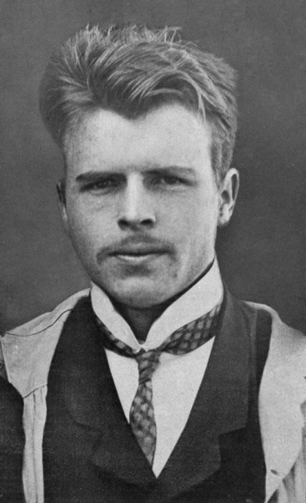
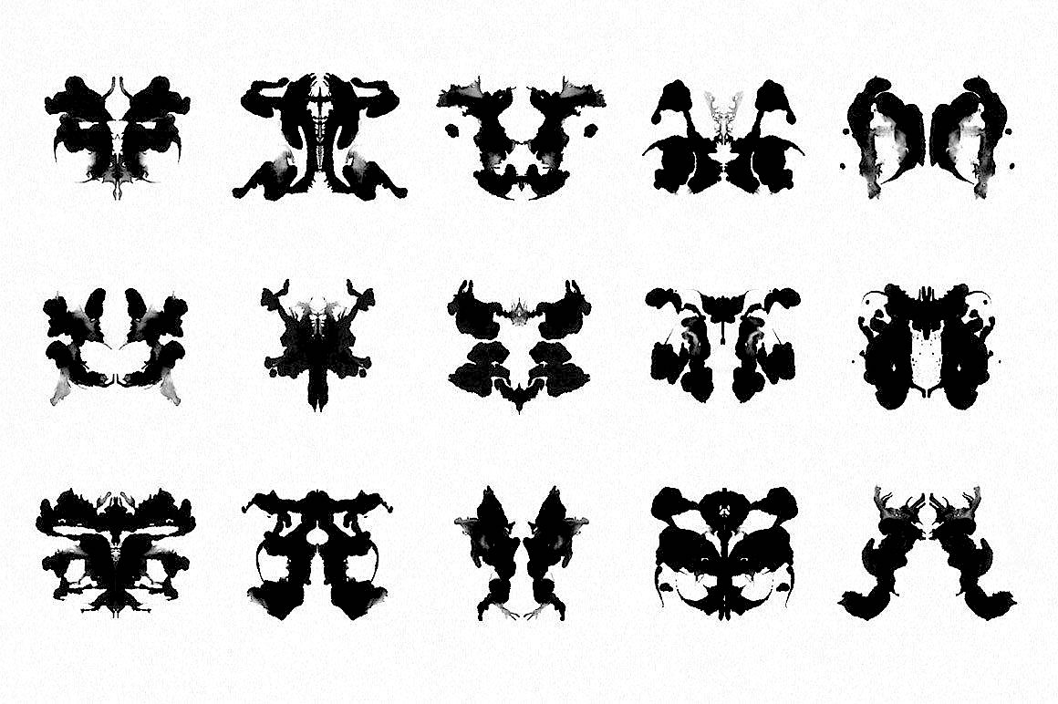
Assessment of Personality
The Rorschach Inkblot Test
Harmann Rorschach
10 inkblots (5 black & white, 2 red & 3 Pastel colours)
Cardboard – 7’’ * 10’’
1st Phase – Performance Paper
2nd Phase - Inquiry

Slide 37
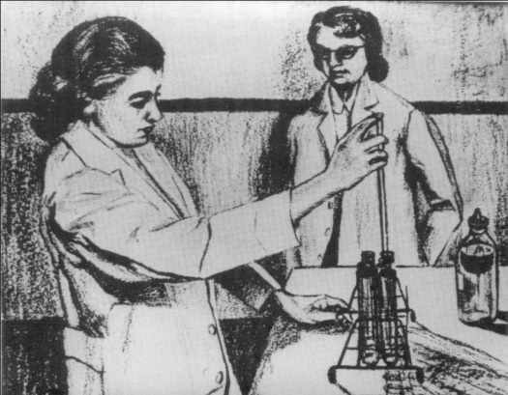
Assessment of Personality
The Thematic Apperception Test
Morgan & Murray
30 B&W picture clards & 1 blank card
Different cards for different audience
Story describing the situation
Indian adaptation of TAT – Uma Chaudhury

Slide 38
Assessment of Personality
Sentence Completion Test
That type of endings used by the subjects reflect their attitudes, motivation & conflicts.
My Father ………………………………….
My greatest fear is ………………………
I am proud of ……………………………..

Slide 39
Assessment of Personality
Draw a person test
1st step - Draw a picture
2nd step – Draw a opposite gender
3rd step – Analysis (standard)

Slide 40
3. Behavioural Analysis
Interview
Observation
Behavioural ratings
Nomination
Situational Tests

