Slide 1
Term 2
Learn Psychology with Vishal Pandey
Chapter 4 Psychological Disorders

Slide 2
Abnormality & Psychological Disorders
1. What is Psychological Disorder?
2. Features of Psychological Disorder
Deviant - different, extreme, unusual, bizarre
Distressing – unpleasant and upsetting to anyone
Dysfunctional – Interfering in daily activities
Dangerous – to self & others

Slide 3
Abnormality & Psychological Disorders
Approaches of Normal & Abnormal Behaviour
Deviation from Social Norms (Terrorists, Amazon)
Maladaptive
Historical Background
Supernatural & Magical forces
Biological or Organic approach
Psychological approach

Slide 4
4. Organismic approach
Hippocrates, socrates, and plato – conflicts between emotion & reason
Galen – Four elements – earth, air, fire & water – blood, black bile, yellow bile & phlegm
Three doshas of vatta, pitta & kapha – Ayurveda & Atharva veda
5. Middle Ages
Demonology & superstition
St. Augustine
6. Renaissance Period
Johann Weyer – Psychological conflicts & disturbed relationships
7. Age of Reason & Enlightenment
8. Bio-psycho-social approach

Slide 5
4. Classification of Psychological Disorders
APA (American Psychiatric Association)
DSM – 5 (Diagnostic & Statistical Manual of Mental Disorders)
ICD – 10 – International Classification of Diseases

Slide 6
Practice Questions
Q1. Explain the 4Ds of abnormal behaviour.
Q2. What do you mean by deviation from social norms?
Q3. What do you mean by maladaptive behaviour?
Q4. How does psychodynamic model explain abnormal behaviour?

Slide 7
Factors underlying Abnormal Behaviours

Slide 8
Factors underlying abnormal behaviour
Biological factors
Faulty genes, endocrine imbalances, malnutrition, injuries.
Due to problems in the transmission of message from one neuron to another.
Anxiety due to low GABA, Schizophrenia due to excess dopamine, depression to low serotonin.
Genetic Factors
Bipolar & related disorders, Schizophrenia, intellectual disability
Psychological Models
Psychodynamic Model – within (Interpsychic) (Internal forces)
Freud {id (instinctual needs, drives & impulses) – Pleasure Principle
ego(Rational thinking) {Conscious decisions}
superego (Moral Standards) {Morality Principle}
Behavioural Model (learned behaviour)
Classical conditioning, operant conditioning, social learning
Cognitive Model (wrong attitude or assumptions about themselves)
Humanistic-existential Model (friendly, cooperative )

Slide 9
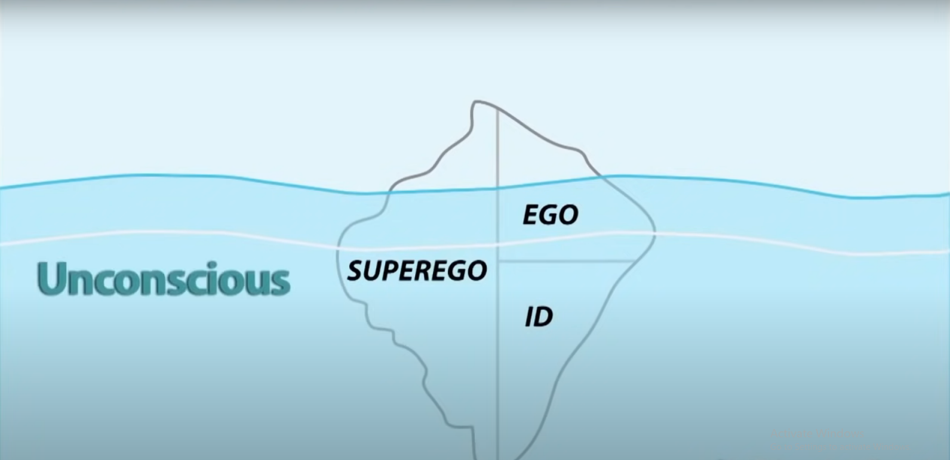

Slide 12
Factors underlying abnormal behaviour
Socio-cultural Model – war & violence, group prejudice & discrimination, economic & employment problems, and rapid social change.
Diathesis-stress Model (biological predisposition)
Diathesis is inherited
Diathesis may carry a vulnerability to develop a psychological disorders.
The presence of pathogenic stressors.

Slide 13
Practice Questions
Q5. What is diathesis-stress model?

Slide 14
Major Psychological Disorders

Slide 15
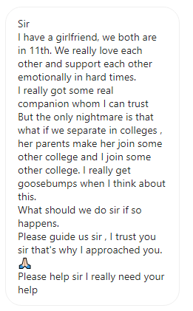
Major Psychological Disorders
Anxiety Disorders
Symptoms
Rapid heart rate, shortness of breath, diarrhea, loss of appetite, fainting, dizziness, sweating, sleeplessness, frequent urination and tremors.
Types of Anxiety:-
Generalised anxiety disorder
Panic disorder
Phobias – Specific phobias, social phobias & agoraphobia
Separation anxiety disorder

Slide 16
Major Psychological Disorders
Obsessive Compulsive Disorder (OCD)
Obsessive behaviour is the inability to stop thinking about a particular idea or topic. (unpleasant & shameful thoughts)
Compulsive behaviour is the need to perform certain behaviours over and over again.
Types of OCD:-
Hoarding disorder
Trichotillomania (hair-pulling disorder)
Excoriation (skin-picking disorder)

Slide 17
Major Psychological Disorders
Trauma & Stressor related Disorders
PTSD – Post Traumatic Stress Disorder

Slide 18
Major Psychological Disorders
Somatic Symptom & Related Disorders
Physical symptoms in the absence of physical disease
Types of Somatic Disorders:-
Somatic symptom disorder
Illness anxiety disorder
Conversion disorder

Slide 19
Major Psychological Disorders
Dissociative Disorders
Dissociation is severance of the connections between ideas & emotions.
Types of Dissociative Disorders:-
Dissociative amnesia – selective memory loss, Fugue
Dissociative identity disorder - MPD
Depersonalisation/Derealisation disorder

Slide 20
Major Psychological Disorders
Depressive Disorders
MDD – Major Depressive Disorder is a period of depressed mood and loss of interest or pleasure in most activities. Other symptoms are change in body weight, constant sleep problems, tiredness, inability to think clearly, agitation, thoughts of death & suicide. Excessive guilt or feelings of worthlessness.
Factors of Depression:
Genetic
Age – women during young adulthood, man during middle age.
Gender
Negative life events & lack of social support

Slide 21
Major Psychological Disorders
Practice Questions
Q. What are the major symptoms of Depression? How is it different from mania?
Q. What do you mean by dissociative disorders?
Q. Explain Separation Anxiety Disorder.
Q. What do you mean by social phobia?
Q. Write any 4 symptoms of panic disorder.
Q. What do you mean by compulsive behaviour?
Q. Write any 3 symptoms of illness anxiety disorder.
Q. What is dissociative amnesia?

Slide 22
Major Psychological Disorders
Bipolar & Related Disorders
Bipolar I: Mania & Depression
Bipolar II: Mania & Depression
Cyclothymic disorder.

Slide 23
Major Psychological Disorders
Schizophrenia Spectrum & Other Psychotic Disorders
Group of Psychotic Disorders
Positive Symptoms (excess of thoughts, emotions & behaviours) – Delusions, disorganized thinking & speech, heightened perception & hallucinations)
2. Negative Symptoms (Deficits of thoughts, emotions & behaviour.
3. Psychomotor symptoms

Slide 24
Major Psychological Disorders
Schizophrenia Spectrum (Positive symptoms)
Delusions
Delusions of persecution - spied
Delusions of reference – personal meanings to objects & events
Delusions of grandeur - specially empowered persons
Delusions of control – their feelings, thought & actions are controlled by others.

Slide 25
Major Psychological Disorders
Schizophrenia Spectrum (Positive symptoms)
2. Formal Thought Disorder
Rapidly shifting from one topic to another.
Loosening of associations, derailment
Inventing new words or phrases (neologisms)
Persistent & inappropriate repetition of the same thoughts (perseveration)

Slide 26
Major Psychological Disorders
Schizophrenia Spectrum (Positive symptoms)
3. Hallucinations
Auditory hallucinations
Tactile hallucinations (forms of tingling, burning)
Somatic hallucinations (snake crawling)
Visual hallucinations (people or objects)
Gustatory hallucinations (food or drink taste strange)
Olfactory hallucinations (smell of poison or smoke)

Slide 27
Major Psychological Disorders
Schizophrenia Spectrum (Negative symptoms)
Poverty of speech (Alogia)
Blunted affect (less anger, sadness, joy or other feelings)
Flat affect (No emotions)
Avolition (inability to start or complete course of action)

Slide 28
Major Psychological Disorders
Schizophrenia Spectrum (Psychomotor symptoms)
Catatonia
Catatonic Stupor
Catatonic rigidity
Catatonic posturing

Slide 29
Major Psychological Disorders
Practice Questions
Q. Explain the factors to prevent suicide.
Q. Define bipolar mood disorder.
Q. What are delusions? Explain delusion of granduer and delusion of persecution.
Q. Explain Formal thought disorder.
Q. Explain the following terms :
Alogia
Avoliation
Flat affect
Catatonic stupor
Neologism
Perseveration

Slide 30
Major Psychological Disorders
Neurodevelopmental Disorders
They manifest in the early stages of development
Deficit or excess in a particular behaviour or age-appropriate behaviour
ADHD – Inattention & hyperactivity
Autism Spectrum Disorder – not social, repetitive speech patterns
Intellectual Disability
Specific learning disability

Slide 31
Major Psychological Disorders
Disruptive, Impulse-control & Conduct Disorders
Oppositional Defiant Disorder
Conduct Disorder
Verbal Aggression
Physical Aggression
Hostile Aggression
Proactive Aggression

Slide 32
Major Psychological Disorders
Feeding & Eating Disorders
Eating Disorders
Anorexia Nervosa
Bulimia Nervosa
Binge Eating

Slide 33
Major Psychological Disorders
Substance-Related & Addictive Disorders
Alcohol
Drinking interferes with social behaviour
It interferes with ability to think & work
Bodies build up tolerance & they need to drink more.
Alcoholism destroys millions of families, social relationships & careers.
It is the reason for many road accidents
It also affects the children of persons with this disorders.
These children face higher rates of psychological disorders.
Excessive drinking can seriously damage physical health.

Slide 34
Major Psychological Disorders
Substance-Related & Addictive Disorders
Heroin
It significantly interferes with social & occupational functioning.
Most abusers develop a dependence on heroin.
The body develop a tolerance for it, thus increasing the intake.
The most direct danger of heroin is an overdose causing death.
Cocaine
Causes poor social relationship & poor at work
It causes problems in short-term memory & attention
Dependence may develop, and more of the drug is needed over time.
Stopping it results in depression, fatigue, sleep problems, anxiety.

Slide 35
Major Psychological Disorders
Substance-Related & Addictive Disorders
Other commonly abused substances
Stimulants - Cocaine
Caffeine – Coffee, tea, chocolate, cocoa
Cannabis – Marijuana or bhang
Hallucinogens – LSD, Mescaline
Inhalants – Gasoline, Paint thinners, sprays
Tobacco – Cigarettes, bidi
Opioid – Morphine, heroin, cough syrup, painkillers
Sedatives, hypnotics, or anxiolytics – sleeping pills, anti-anxiety medication.

Slide 36
Major Psychological Disorders
Practice Questions
Q. Explain Hyperactivity.
Q. Write any 4 symptoms of ADHD.
Q. How will you diagnose Conduct disorder?
Q. Explain major symptoms of Autism.
Q. Explain the term Specific Learning Disorder.
Q. Explain the types of aggression.
Q. Explain various effects of alcohol.
Q. Explain the major symptoms of Bulimia.

Slide 37
Psychological Disorders
Important words to remember
Abnormal Psychology
Antisocial Behaviour
Anxiety
Autism
Bipolar & related Disorders
Delusions
Depressive Disorders
Diathesis-stress model
Feeding & eating disorders
Genetics
Hallucinations
Hyperactivity
Intellectual disability
Neurodevelopmental disorders
Neurotransmitters
Norms
Obsessive-compulsive disorders
Phobias
Schizophrenia
Somatic symptom

Slide 38
ThankYou
Notes available at www.careerinnova.com
Instagram – career_innova
Youtube :
CareerInnova
Learn Psychology with vishal pandey

