Slide 1
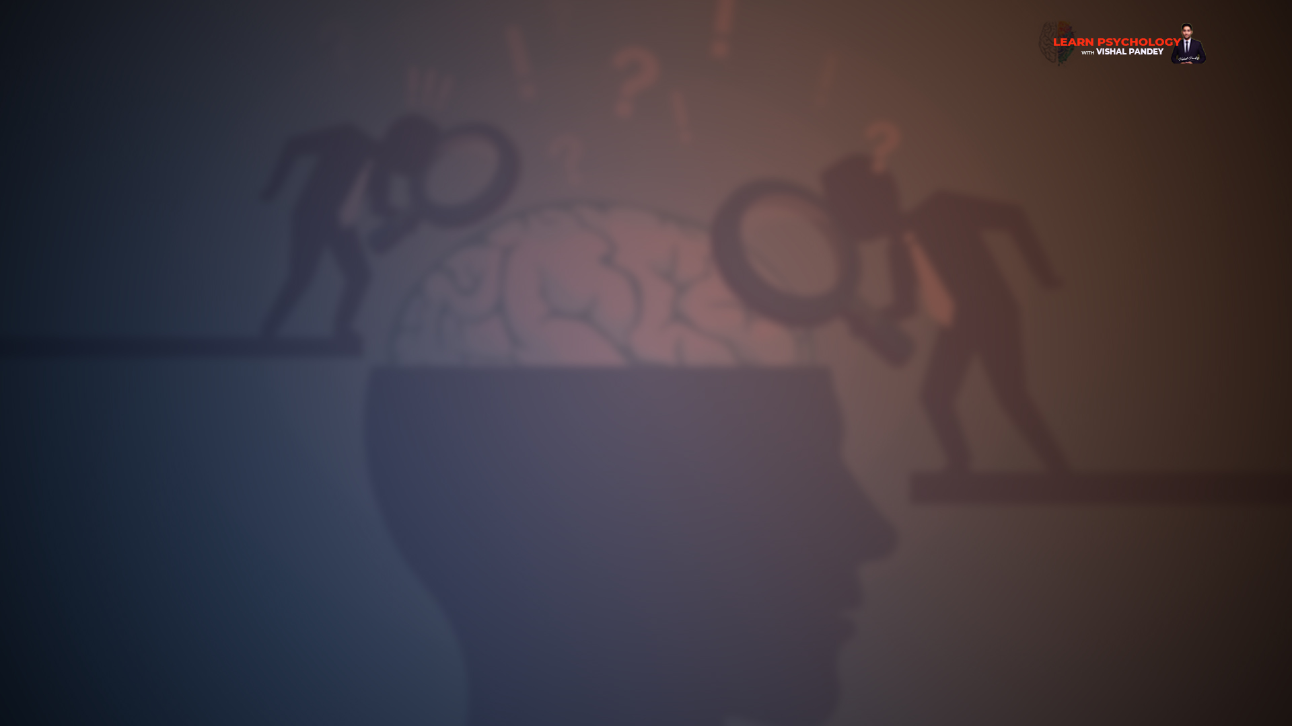
Term 2
Learn Psychology with Vishal Pandey
Chapter 6 Attitude & Social Cognition

Slide 2
Attitude: Ways of thinking about specific topics & people
Impression Formation: When we meet people, we make inferences about their personal qualities.
Attribution: we assign causes to the behaviour shown in specific social situations.
These three mental activities related to gathering interpretation of
information about the social world, collectively called
Social Cognition
Moreover, social cognition is activated by cognitive units called
schemas.

Slide 3
Examples of Social Influence are in the form of observable behaviour.
Social Facilitation/Inhibition : Improvement/decline in the performance in presence of others.
Pro-Social Behaviour: responding to others who are in need or distress.

Slide 4
ABC components of Attitude
Affective Aspect – Emotional Component
Behavioural Aspect – The tendency to act
Cognitive Aspect – The thought component
Attitude Object - Set of views or thoughts, regarding some topic
How Attitude is different from Beliefs & Values?
Beliefs refer to cognitive components of attitudes, and form
the ground on which attitudes stand.
Values are attitudes or beliefs that contain a ‘should’ or
‘ought’ aspects, such as moral or ethical values.
(inseparable part of the person’s outlook on life)

Slide 5
Features of Attitude
Valence – Scale of Attitude (Positive or Negative)
Extremeness – Level (extremely positive or negative)
Simplicity or Complexity
Centrality

Slide 6
Attitude Formation & Change
Attitude Formation
Process of Attitude Formation
Learning attitudes by association
Learning attitudes by being rewarded or punished
Learning attitudes through modelling (observing others)
Learning attitudes through group or cultural norms
Learning attitudes through exposure to information
Factors that influence Attitude Formation
Family & School Environment
Reference Groups
Personal Experiences
Media-related Influences

Slide 7
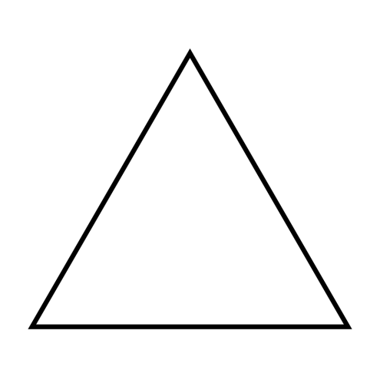
Attitude Change
Attitudes that are still in formative stage, and are more like
Opinions, are much more likely to change compared to attitudes that have become firmly established, and have become a part of individual’s values.
Applications of attitude change is administered by Politicians,
Producers of consumer goods, advertisers and others.
Process of Attitude Change
The concept of balance – Fritz Heider POX Triangle
The concept of cognitive dissonance – Leon Fristinger
The two-step concept –SM Mohsin
P (Person whose attitude is being studied)
O (Another person)
X (Topic)
Cognitive Consistency
Observational Learning
Imbalance
Balance
P - O | O - X | X - P
- | - | -
- | + | +
P - O | O - X | X - P
+ | + | +
- | - | +

Slide 8
Attitude Change
Factors that influence Attitude Change
Characteristics of the existing attitude
Valence, Extremeness, Simplicity or Complexity & Centrality
Positive attitudes are easier to change than negative attitudes are
Extreme attitudes, and central attitudes are more difficult to change than less extreme and peripheral attitudes
Simple attitudes are easier to change than multiple attitudes.
Congruent or incongruent
Source Characteristics
Credibility
Attractiveness
Message Characteristics
Rational
Emotional appeal
Motives
Mode
Target Characteristics
Persuasibility
Strong Prejudices
Self-esteem
Intelligence

Slide 9
Attitude – Behaviour Relationship
We usually expect behaviour to follow logically from attitudes.
There would be consistency between attitudes and behaviour when:
The attitude is strong, and occupies the central place in the attitude system.
The person is aware f her/his attitude
There is very little or no external pressure for the person to behave in a particular way.
The person’s behaviour is not being watched or evaluated by others
The person thinks that the behaviour would have a positive consequence, and therefore, intends to engage in that behaviour.

Slide 10
Prejudice & Discrimination
Stereotypes
Sources of Prejudice
Learning
A strong social identity and ingroup bias
Scapegoating
Kernel of truth concept
Self-fulfilling prophecy

Slide 11
Strategies for handling prejudice
Minimising opportunities for learning prejudices.
Changing such attitudes
De-emphasising a narrow social identity based on the ingroup.
Discouraging the tendency towards self-fulfilling prophecy among the victims of prejudice.
These goals can be accomplished through:-
Education & information dissemination
Increasing intergroup contact allows for direct communication
Highlighting individual identity rather than group identity.

Slide 12
Social Cognition
How society or Social world does all the mental processes that deal with obtaining & processing of information is ‘Social Cognition’
These include all the processes that help in understanding, explaining & interpreting social behaviour.
A person may show a difference in her/his behaviour, depending on who is watching him.
Social Cognition is guided by mental units called Schemas
Schemas & Stereotypes
A Schema is defined as a mental structure that provides a framework, a set of rules or guidelines for processing information about any object.
Schemas are the basic units stored in the memory, and function as shorthand ways of processing information, thus reducing the time and mental effort required in cognition.
In the case of social cognition, the basic units are social schemas.
Schemas in the form of categories are called Prototypes, which are the entire set of features or qualities that help us to define an object completely.
In Social Cognition, category based schemas that are related to groups of people are called stereotypes. (Positive & Negative)

Slide 13
Impression Formation & Explaining Behaviour of Others through Attributions
Impression formation - The Perceiver gathers information, or responds to a given information, about the qualities of the target, organises this information, and draws inferences about the target.
Perceiver
Target
Attributions - The Perceiver goes further, and explains why the target behaved in a particular way.
Attaching or assigning a cause for the targets behaviour is the main idea in attribution.
Impression formation & Attribution is influenced by:
The nature of information available to the perceiver
Social schemas in the perceiver (including stereotypes)
Personality characteristics of the perceiver
Situational factors.

Slide 14
Impression Formation
Selection
Organisation
Inference
Primacy Effect
Recency Effect
Halo Effect – person with one positive quality must also be having other specific positive quality.
Attribution of Causality
Cause can be Internal or external.
Causes can be stable or unstable.
Fundamental Attribution error
Internal > external
Success to internal & Failure to external
Actor – Observer Effect
Actor – Own Positive & negative experience
Observer – Others Positive or negative experience
The basic reason for the difference between the actor & observer roles is that people want to have a nice image of themselves, as compared to others.

Slide 15
Behaviour in the Presence of Others
Social Facilitation – Performance on specific tasks in influenced by the mere presence of others.
Zajonc – Because the person experience arousal, which makes the person react in a more intense manner
Evaluation Apprehension by Cottrell – the arousal is because the person feels she or he is being evaluated. (reward or punishment)
Nature of the task – A familiar task vs complex or new task
Co-action
Social Loafing – the larger the group, the less effort individual puts.
Diffusion of responsibility – Saas / Bahu

Slide 16
Pro-Social behaviour
Altruism – which means doing something for or thinking about the welfare of others without any self-interest.
Examples of Pro-social – Sharing things, cooperating with others, helping during natural calamities, showing sympathy, doing favours to others, and making charitable donations.
Characterisitcs
Factors influencing Pro-Social Behaviour
Inborn tendency
Learning
Cultural factors
Social norms
The norm of Social responsibility
The norm of Reciprocity
The norm of Equity
Expected reaction of person being helped
High level of Empathy
Bad mood, internal attribution might reduce the pro-social behaviour
It might also be reduced when the number of bystanders is more than one
Diffusion of responsibility

